Slide 1

Codeasylums-Case Study Challenge Recommendation
By- Pratik Jaiswal

Slide 2
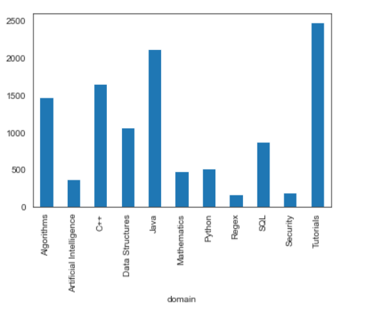
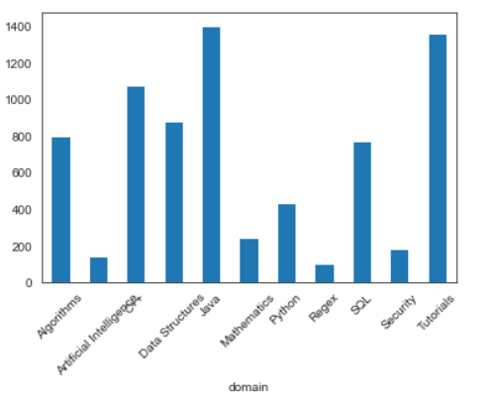
Data Analysis
Given Files:
Challenges, Submissions
Challenges:
Contains data about challenge-ids, contest-ids, domain, difficulty , solved counts,etc.
By EDA, its found that problems belonging to Implementation, Introduction and Sorting have the 3 highest number of challenges.
Belonging to Domain, Tutorials, Java and C++ were the three highest with respect to number of total submissions.

Slide 3
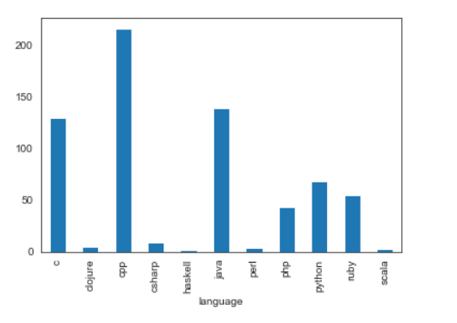
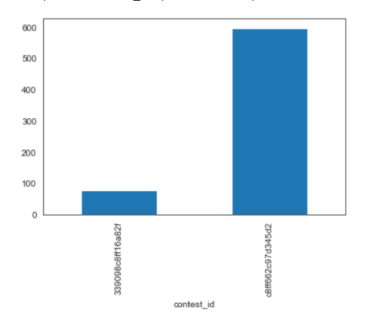
Submissions:
It contains user data base with the challenges they attempted or solved.
The aim is to use the challenges and submission data to recommend ten challenge ids for each user.
By EDA, C++, Java and C were the three most used languages for attempting challenges used.
Only Two contest Ids are present on the already existing submission data.

Slide 4
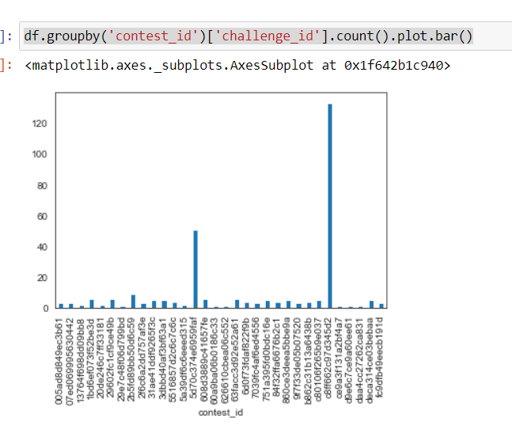
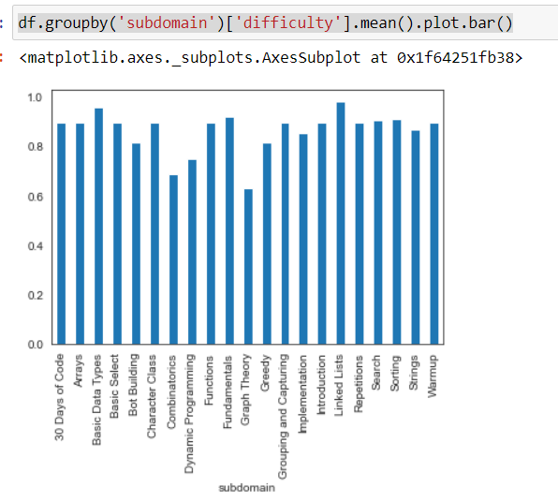
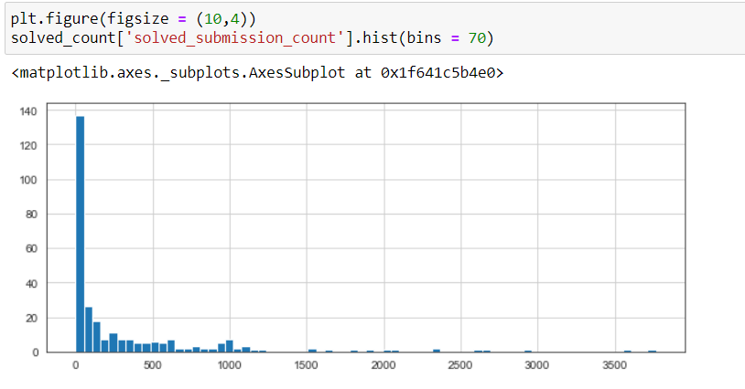
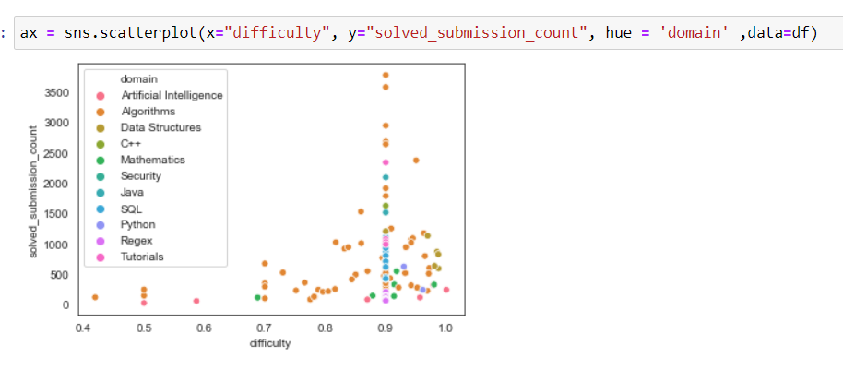
Some other Charts for reference

